Slide 1

Python WORKSHOP

Slide 2
Team number
15

Slide 3
title
PENALTY SOCCER game

Slide 4

team name
RAMPAGE’S SOCCER TEAM

Slide 5
TEAM MEMBERS
ABISHRAJ.K (ER) [18IT01]
ALTEN.C (ER) [18IT02]
ANUSUYA (ER) [18IT03]

Slide 6
ACADEMIC MENTOR :
(ER) SATHISH.R M.E.,(PhD).,
Assistant professor,
Dept of IT.KITE

Slide 7
INDUSTRY MENTOR
MS SUBASHINI.U
ASSOCIATE
KGISL GSS

Slide 8
ABSTRACT
The title of our game is penalty soccer game .This project is about a penalty game in football . This project was developed by using python pygame . There are one players in the game . We are focusing developing a 2D Penalty Soccer Game . Each player will have a 5 penalty shoots. In this game Goal Keeper will save the ball or allow the ball . If Goal Keeper allow the ball the point will increase by 1 for each player . If Goal Keeper save the ball the point will not increase and decrease for each player.In order to improve the match success rate, we proposed a penalty kick strategy based on two-player shooting method which is used in two different defense patterns. In this strategy, a shooting method is applied when the opponent goalkeeper run out to destroy the ball and a reflecting shooting method is used when the goalkeeper stays at the goal line.

Slide 9
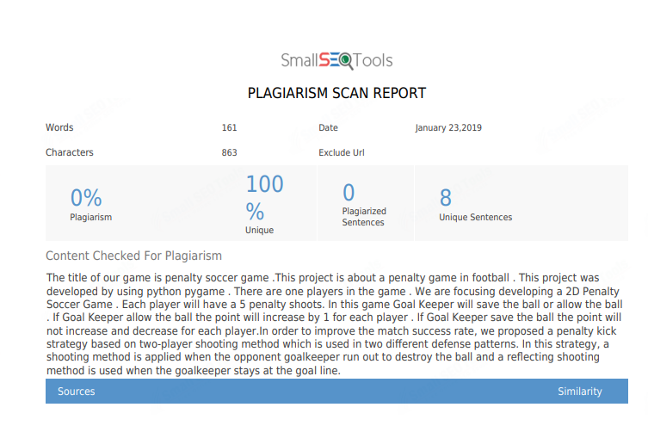

Slide 10
introduction
A Comprehensive Introduction to Pygame. Welcome to an introduction to Pygame. . The course covers the basic setup of a Pygame file, drawing images and getting input, all the way to the use of built-in Sprites and Rects for game functionality. Pygame is a great tool for developers. This pygame is about a penalty soccer game.

Slide 11
MODULES
GAME TYPE : PENALTY SOCCER GAME
PLAYERS : ONE PLAYER
LEVEL : ONE LEVEL
PENALTY SHOOT : EACH PLAYER HAS 5 SHOOT
TIME : THERE IS NO TIME
SCORE : BASED ON GOAL WE CALCULATE THE SCORE

Slide 12
REQUIREMENTS
HARDWARE :
PENTIUM 4
SOFTWARE :
THONNY
LANGUAGE :
PYTHON

Slide 13
modules
start the game
Two players
Player 1 shoots the ball
Goalkeeper saves the ball or allows the ball
Player 2 shoots the ball
Goalkeeper saves the ball or allows the ball
After five shoots of each player
End of the game

Slide 14
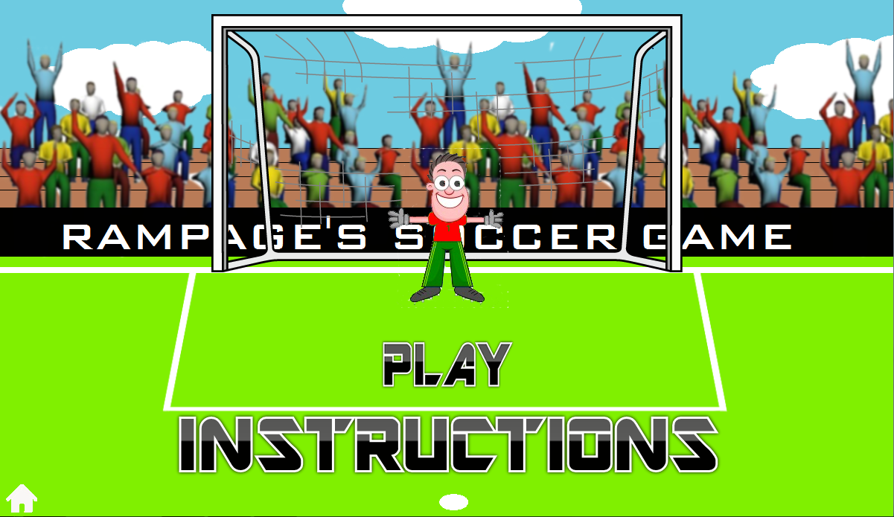
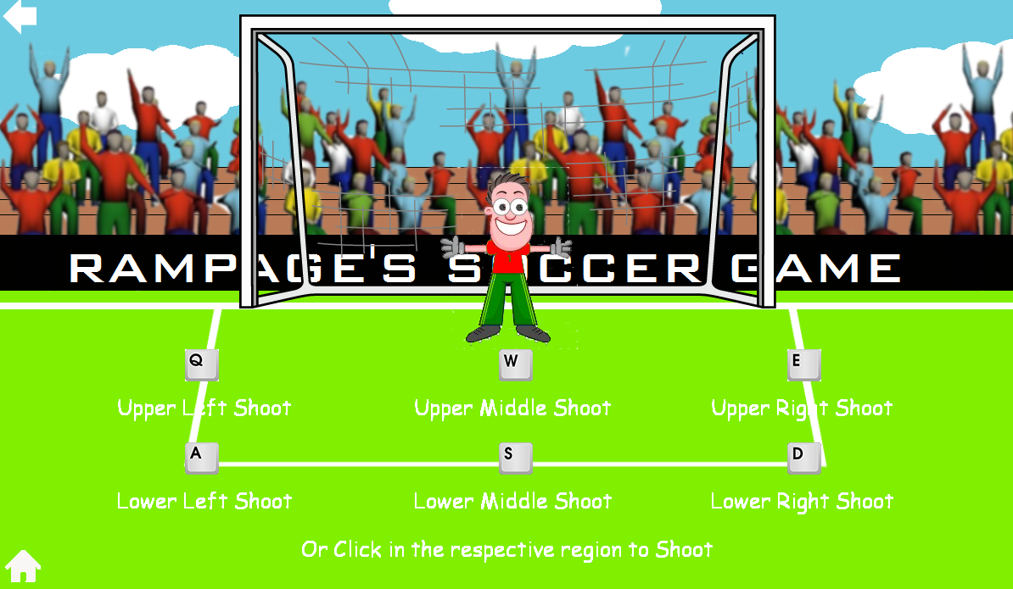
pygame

Slide 15
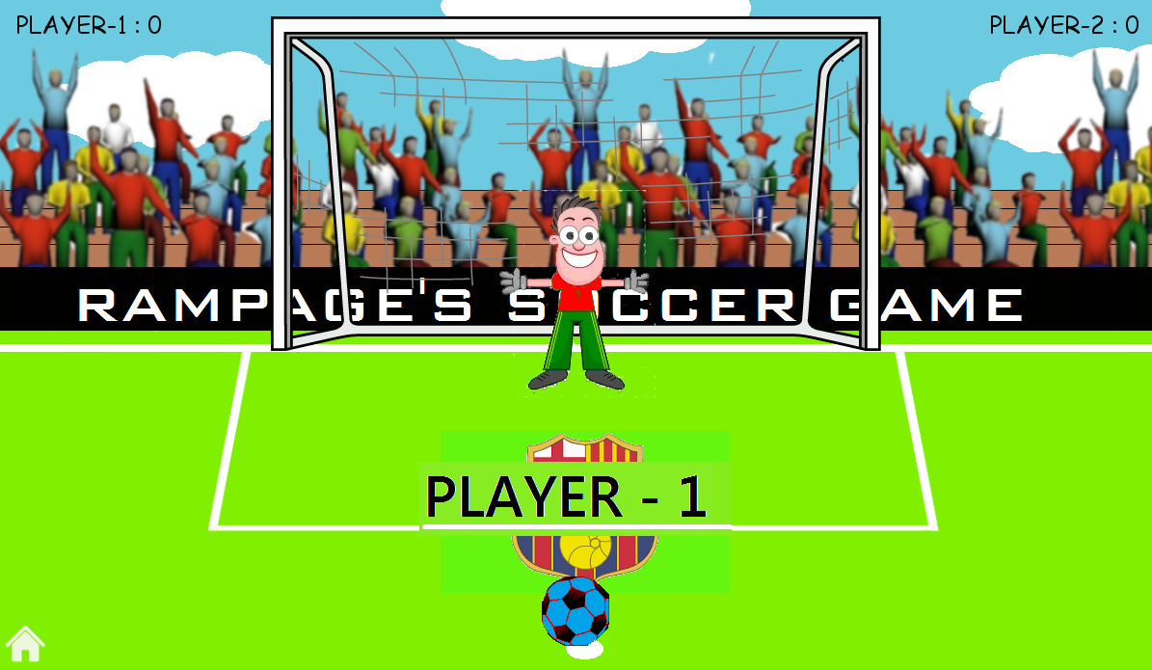
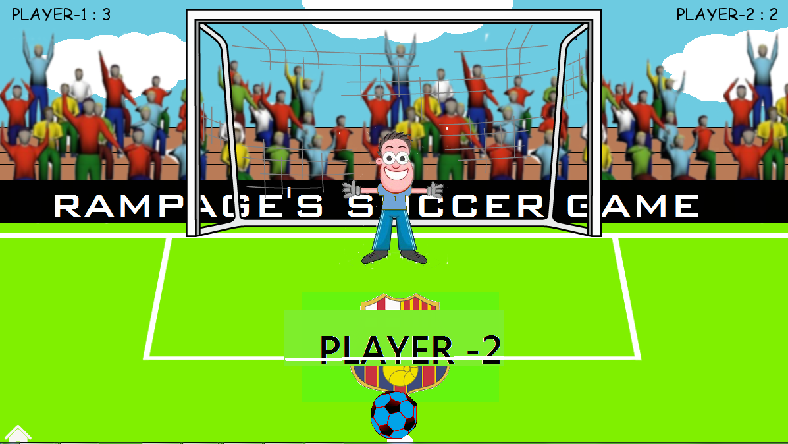
PYGAME

Slide 16
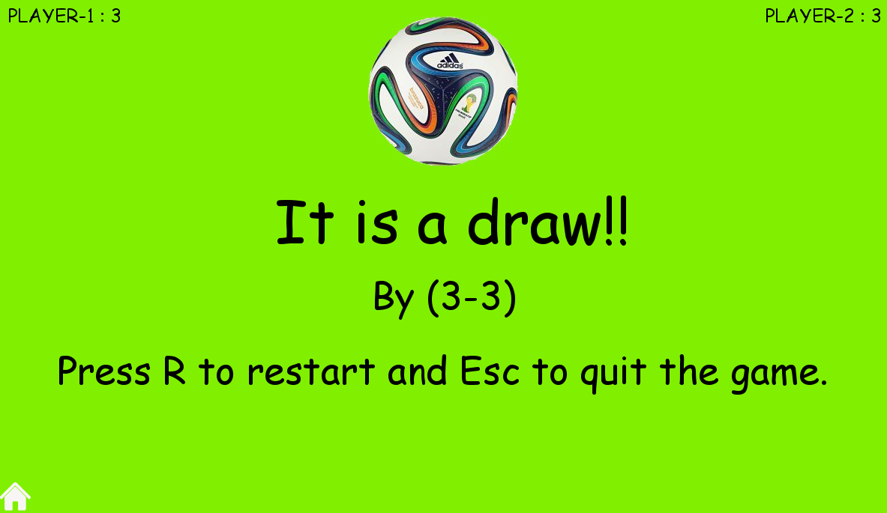
PYGAME

Slide 17
REFERENCE
https://github.com/Shivam010/Penalty-ShootOut-Game

Slide 18
conclusion
The pygame is successfully developed.

Slide 19
Thank you…….

